Slide 1
SDS PROJECT
By
Saket Mishra (PES1UG19CS422)
Sammed D Tapakire (PES1UG19CS426)
Saif Kamalsha (PES1UG19CS420)
Samarth Kumar (PES1UG19CS424)

Slide 2
UDEMY COURSES

Slide 3
Problem Statement
The project belong to obtain dataset, cleaning and analyzing, graphing and standardizing it, make a hypothesis and testing it on sample data, correlation variables and make inference.

Slide 4
Overview
Data Cleaning
Graph Visualization
Normalization and Standardization
Hypothesis Testing
Correlation

Slide 5
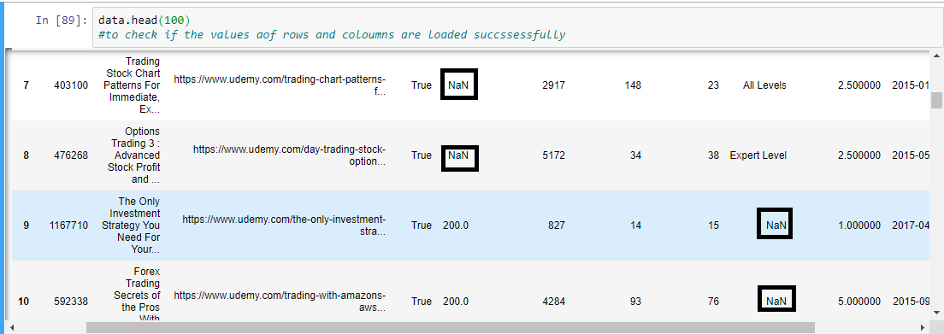
Data Cleaning - Before Cleaning

Slide 6
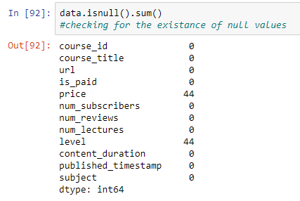
Data Cleaning
Before Cleaning

Slide 7
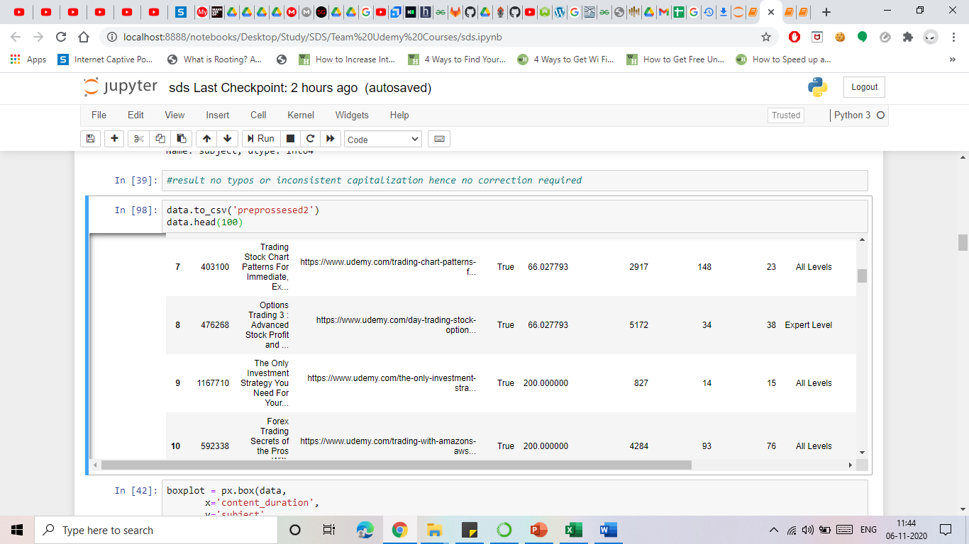
Data Cleaning - After Cleaning

Slide 8
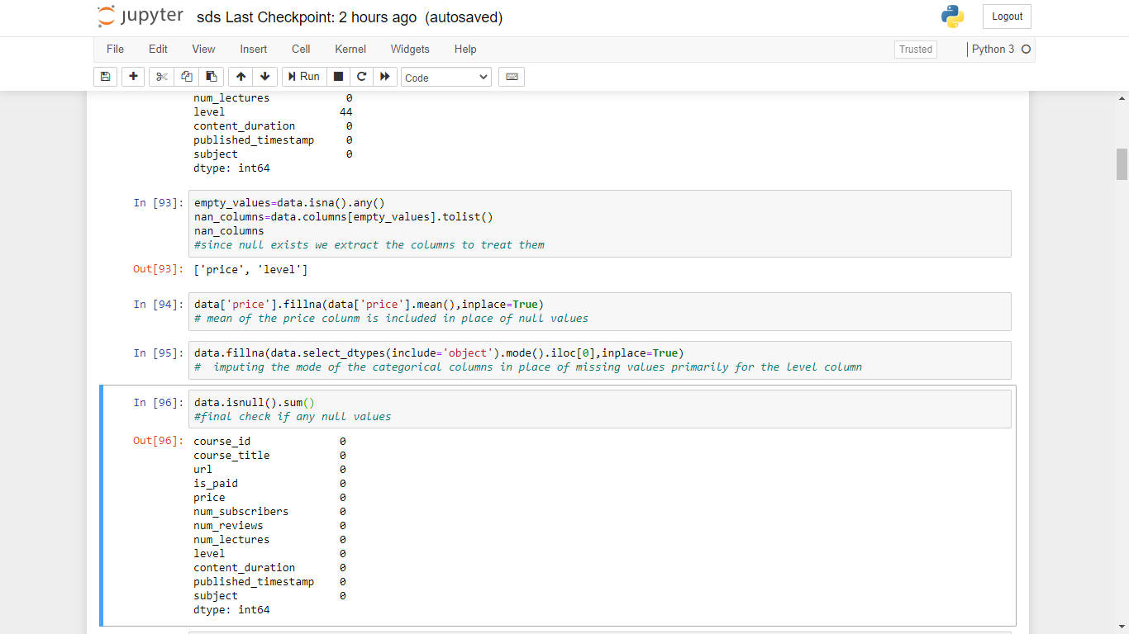
Data Cleaning
After Cleaning

Slide 9
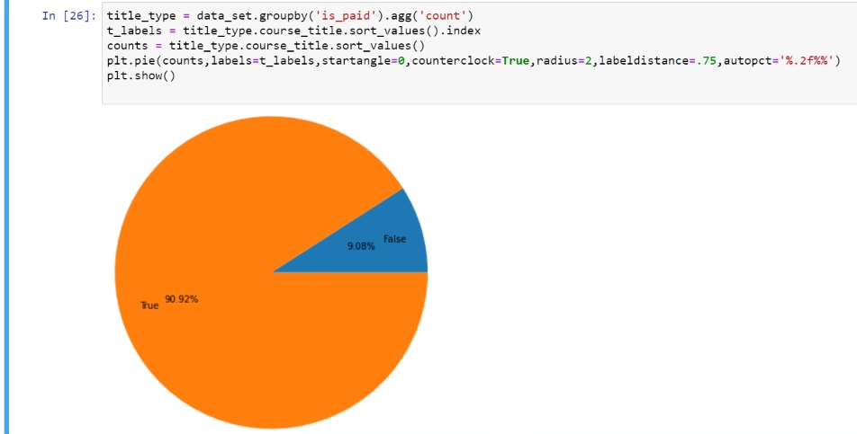
Graph Visualization
Paid or Unpaid

Slide 10
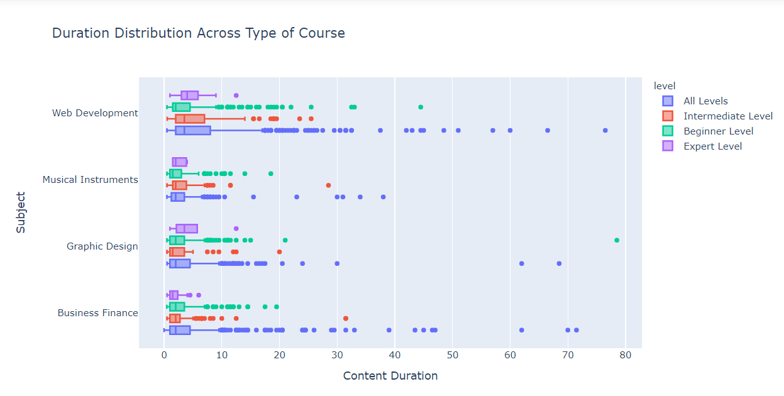
Before Normalization

Slide 11
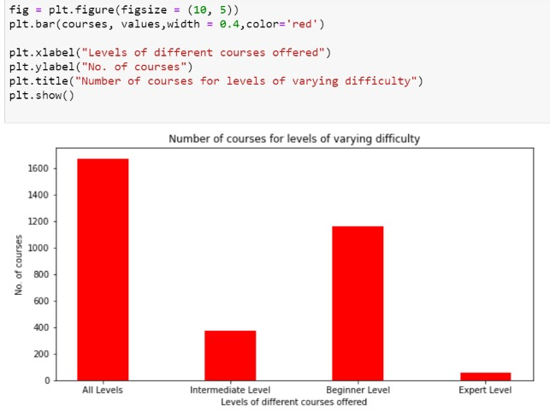
Graph Visualization
Number of Courses for varying level of difficulty

Slide 12
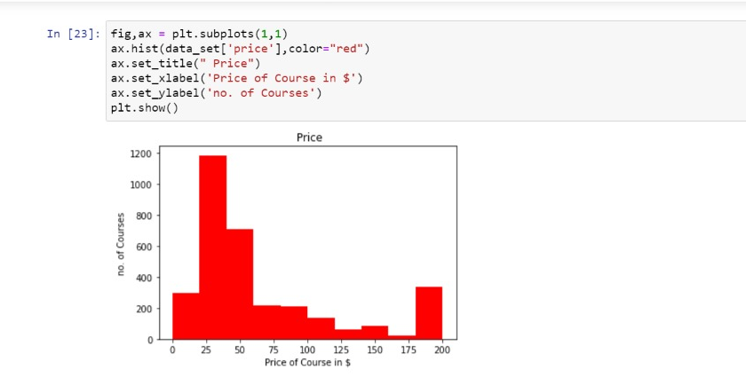
Graph Visualization
Histogram of Price

Slide 13
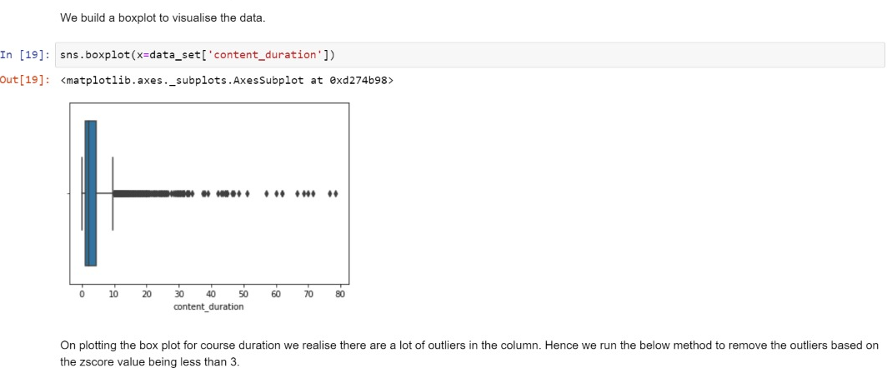
Graph Visualization
Analyzing Course Duration Distribution

Slide 14
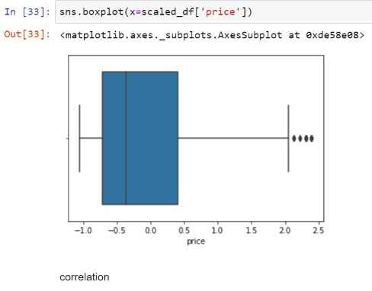
Graph Visualization
Analyzing Price Distribution

Slide 15
Normalization and Standardization
The goal
of data
normalization
is to reduce
and even
eliminate data redundancy

Slide 16
Importance of Normalization
Normalization is to change the values of numeric columns in the dataset to a common scale, without distorting differences in the ranges of values
In our case: price and number of subscriber. price has a range of 0 to 200 whereas number of subscribers has a range of 0 to 161029. Normalizing helps us compare these columns

Slide 17
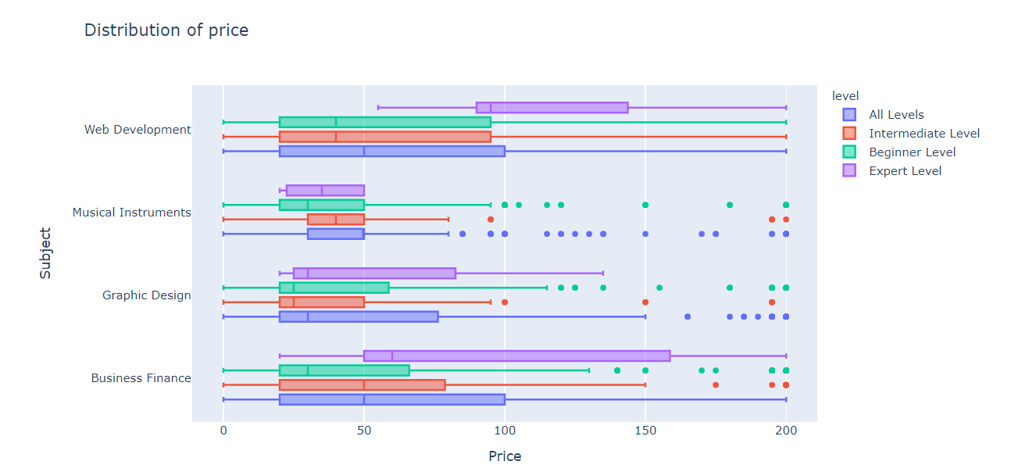
Normalized

Slide 18
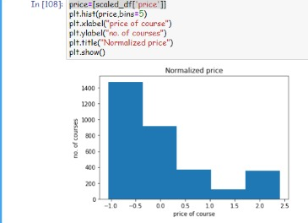
Graph Visualization
Histogram of Price- Normalized

Slide 19
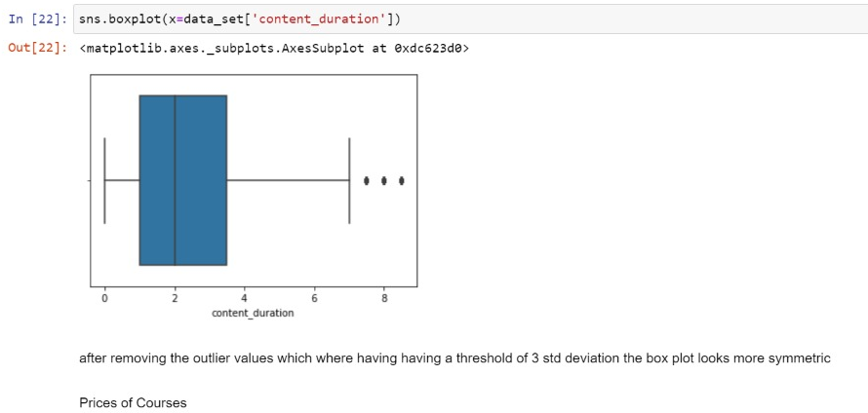
Graph Visualization
Analyzing Course Duration Distribution Box-Plot on removal of outliers

Slide 20
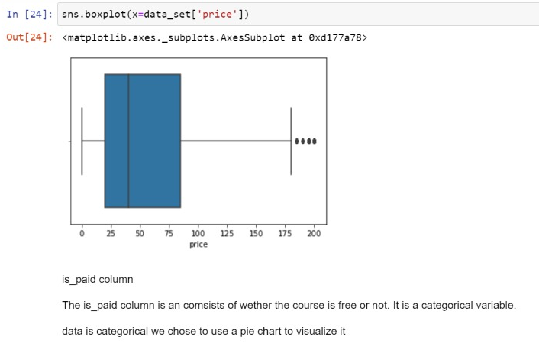
Graph Visualization
7. Analyzing Price Distribution Box-Plot on removal of outliers

Slide 21
Hypothesis Testing
In our data set as the number of subscribers play great role ,it was only appropriate that our hypothesis was based on the number of subscribers
Our research Hypothesis is
Null Hypothesis;
H0 : The average no. of subscribers for web development courses is greater than 5500.
Alternate Hypothesis
Ha : The average no. of subscribers for web development courses is lesser than or equal to 5500

Slide 22

Hypothesis Testing
Here the population parameter is :Population mean
The population here consist all the web development courses in dataset

Slide 23


Hypothesis Testing
Method used is P-Value test
After the P-Value test we obtain the below statistics
After performing Z test

Slide 24
Here, we see that the P-value is greater than the alpha (0.05) value. Hence, we conclude that both H0 and Ha are plausible. In this case, a sample has a 38.9% probability of disagreeing with H0.

Slide 25
Correlation
Correlation refers to the act where a certain variables value could be dependent on another variable. Correlation often helps in connecting multiple variables of a dataset.
But it is very important to keep in mind that correlation does not imply causation i.e. just because two variables have a strong positive or negative correlation, does not imply they are related.
Variables could have a positive correlation when increase in variable A results in increase in variable B.
Variables could have a negative correlation when decrease in variable A results in increase in variable B.
Variables could have neutral correlation when a change in variable A does not impact the value of variable B

Slide 26
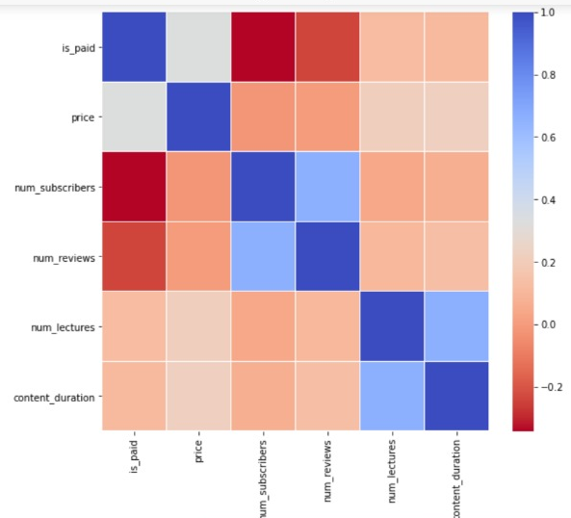
Correlation
Insights from Graph
Here we say that the diagonal is filled with ones owing to the correlation between a column and itself.
The is_paid column tends to share a negative correlation with num_suscribers probably because users are more likely to access free content over paid. This also likely to be the reason for a negative correlation with num_reviews as well.
Price has a very tiny amount of correlation with num_subscribers and num_reviews because certain courses could be free, their level could also impact the count.

Slide 27
Conclusion
It proves that it requires so many features than available to predict that which courses keep attention of users and push them to subscribe that course.
Correlation of property of various column as well as hypothesis test, subscribers are related to the subject .
Graph demonstrate that payment aspect of a courses does not hinder a humans passion to learn.
Maximum number courses are available in All Levels(1654 courses) and this levels have maximum number of subscribers.
Minimum number of courses available in Experts Levels (55) and this levels have minimum number of subscribers.
This project demonstrate that how genric and common assumption could be wrong such correation between price and subscribers .

Slide 28
Thank You

